Slide 1
Lecture 5: Representation Learning
Kai-Wei Chang
CS @ UCLA
kw@kwchang.net
Couse webpage: https://uclanlp.github.io/CS269-17/

Slide 2
This lecture
Review: Neural Network
Recurrent NN
Representation learning in NLP

Slide 3
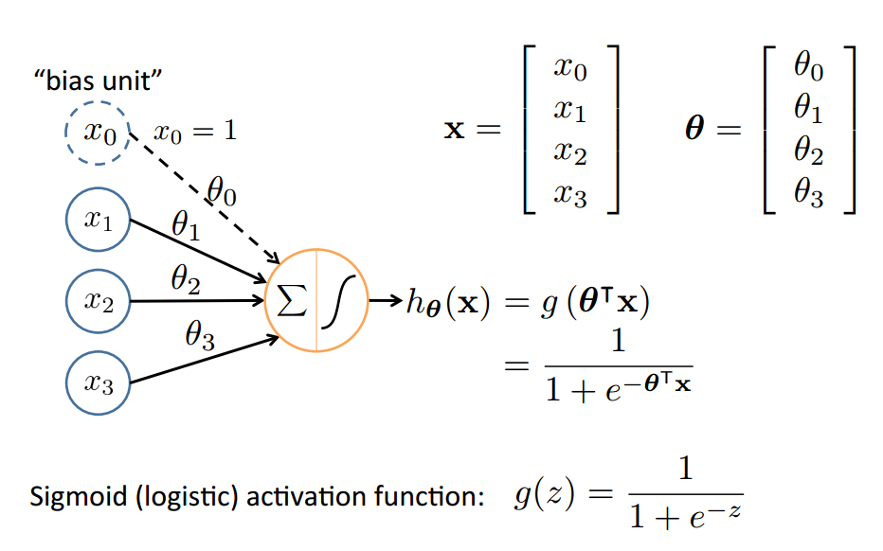
Neural Network
Based on slide by Andrew Ng
10

Slide 4
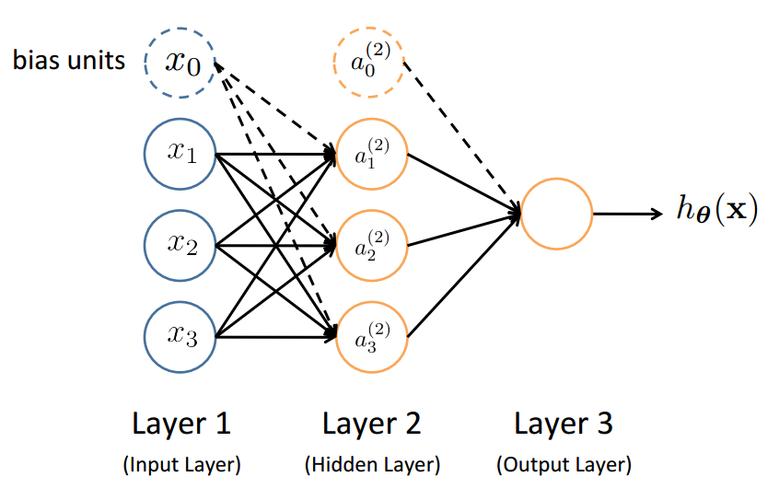
Neural Network (feed forward)
Slide by Andrew Ng
12

Slide 5
Feed-Forward Process
Input layer units are features (in NLP, e.g., words)
Working forward through the network, the input function is applied to compute the input value
E.g., weighted sum of the input
The activation function transforms this input function into a ﬁnal value
Typically a nonlinear function (e.g, sigmoid)
Based on slide by T. Finin, M. desJardins, L Getoor, R. Par
13

Slide 6
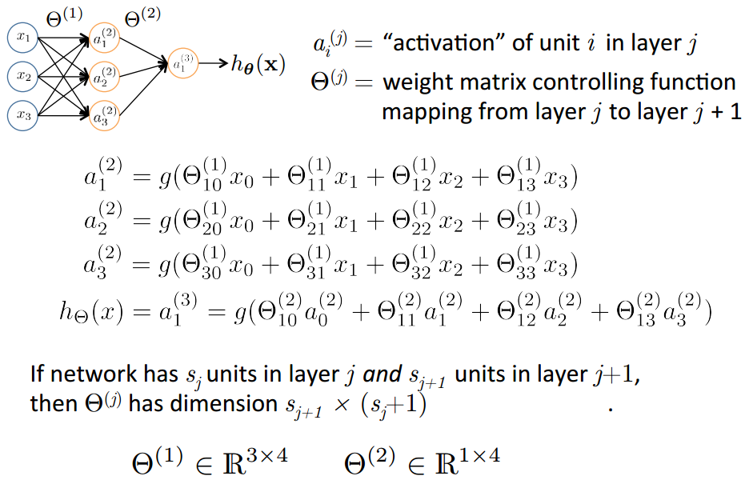
Slide by Andrew Ng
14

Slide 7
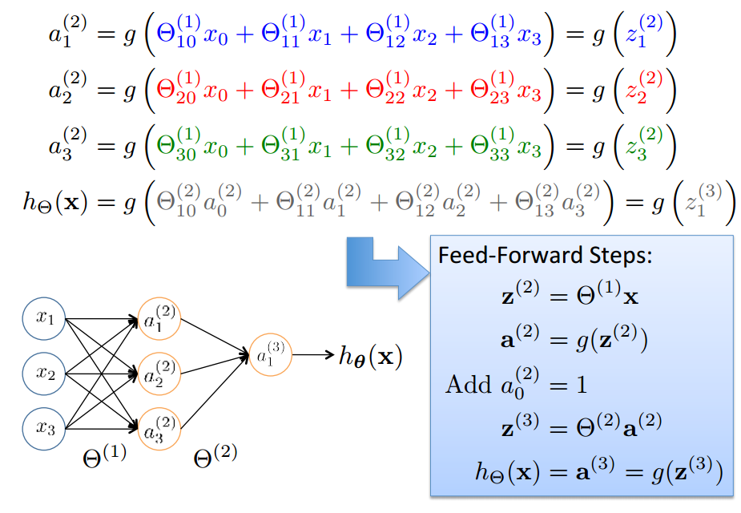
Vector Representation
Based on slide by Andrew Ng
15

Slide 8
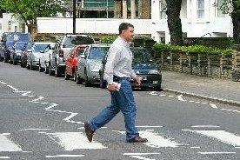


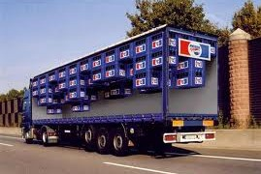
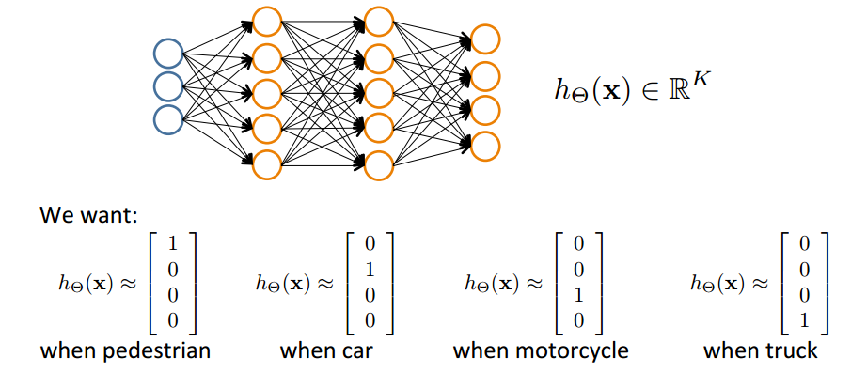
Can extend to multi-class
Pedestrian
Car
Motorcycle
Truck
Slide by Andrew Ng
17

Slide 9
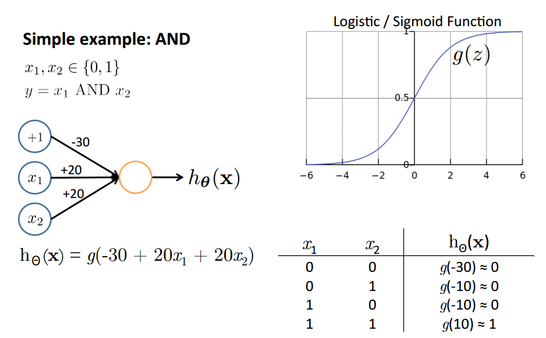
Why staged predictions?
Based on slide and example by Andrew Ng
21

Slide 10
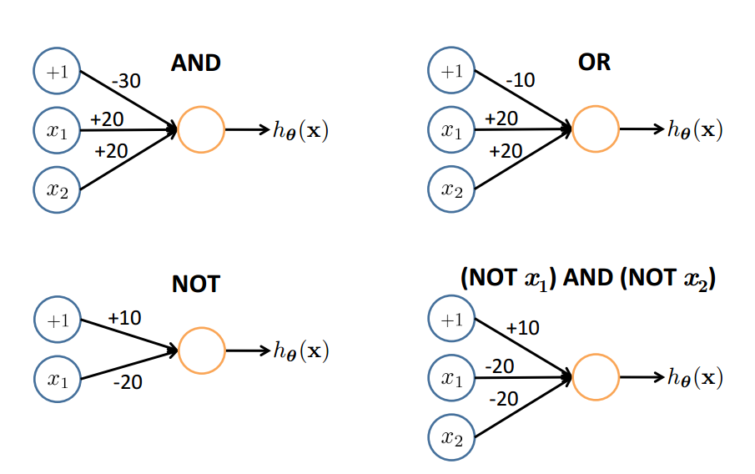
Representing Boolean Functions
22

Slide 11
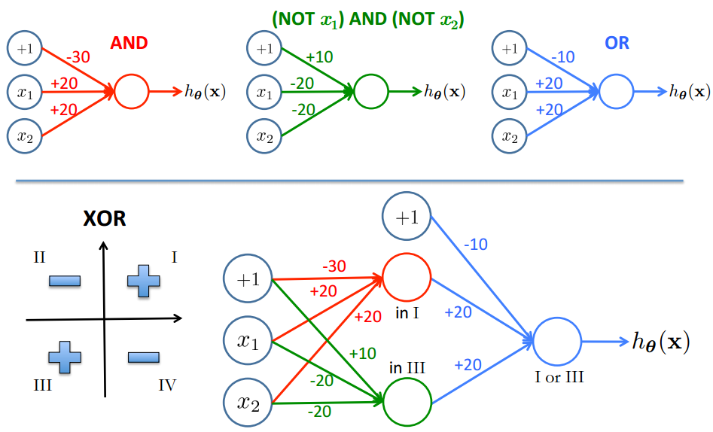
Combining Representations to Create Non-­Linear Functions
Based on example by Andrew Ng
23

Slide 12
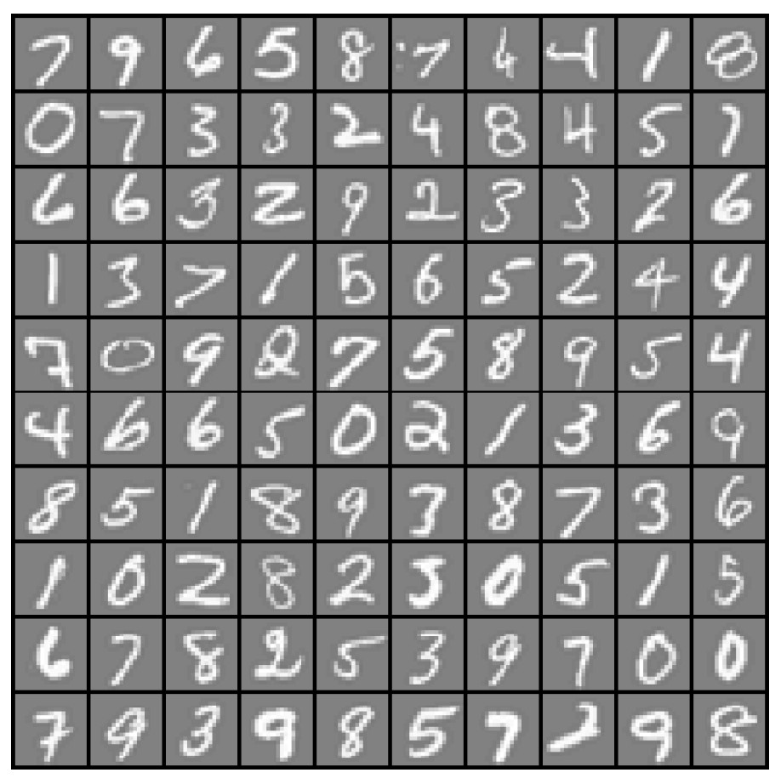

Layering Representations
x₁ ... x₂₀
x₂₁ ... x₄₀
x₄₁ ... x₆₀
...
^{x}381 ^{... x}400
20 × 20 pixel images
d = 400 10 classes
Each image is “unrolled” into a vector x of pixel intensities

Slide 13
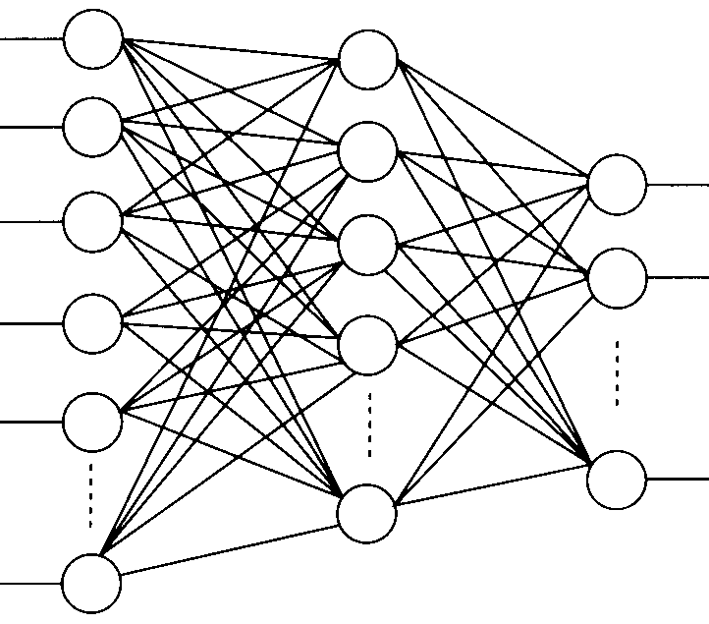
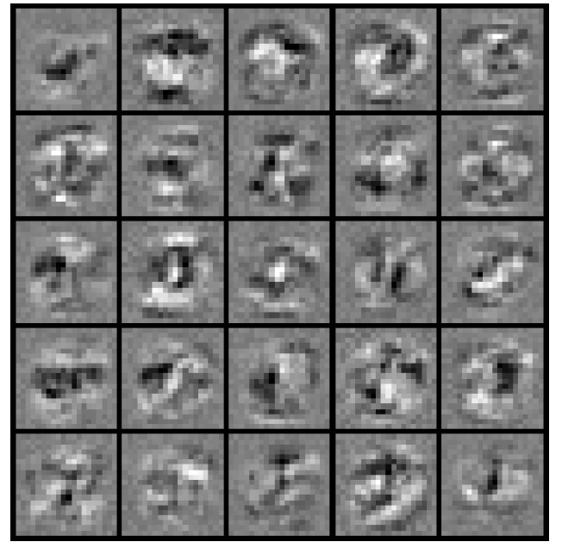
Layering Representations
x₁
x₂
x₃
x₄ x₅
Output Layer
“0”
“1”
“9”
x_{d}
Hidden Layer
Input Layer
Visualization of Hidden Layer

Slide 14
This lecture
Review: Neural Network
Learning NN
Recursive and Recurrent NN
Representation learning in NLP

Slide 15
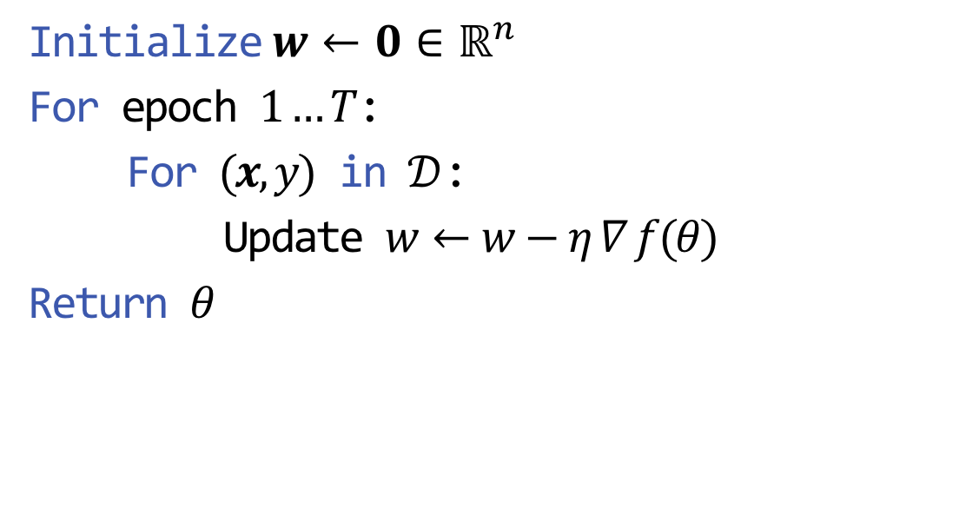
Stochastic Sub-gradient Descent
Given a training set $𝒟=\{\left(x, y\right)\}$
Initialize $w←0∈ℝ^{n}$
For epoch $1…T$:
For $(x,y)$ in $𝒟$:
Update $w←w−η ∇ f(θ)$
Return $θ$

Slide 16
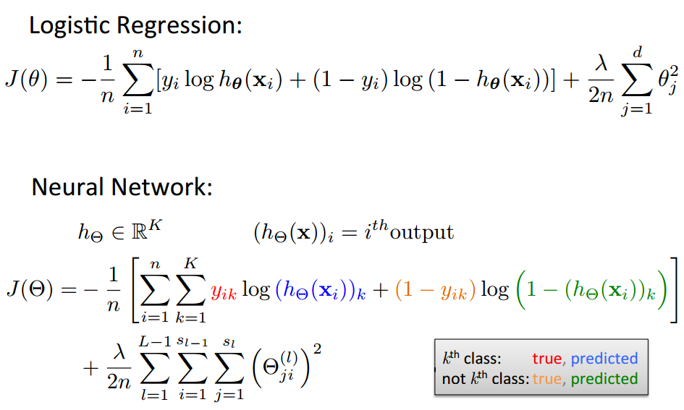
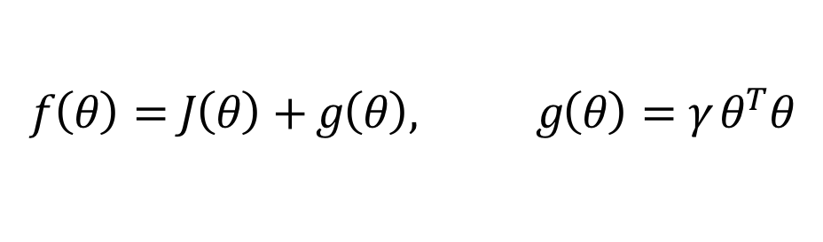
Cost Function
$$f\left(θ\right)=J\left(θ\right)+g\left(θ\right), g\left(θ\right)={γ θ}^{T}θ$$
Based on slide by Andrew Ng

Slide 17
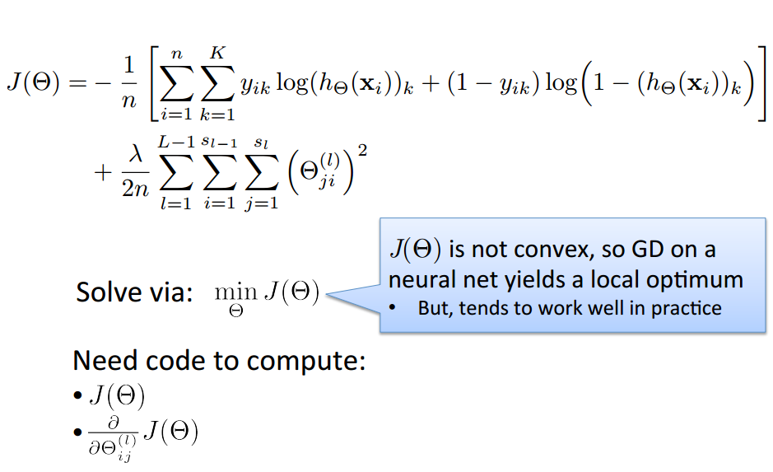
Optimizing the Neural Network
Based on slide by Andrew Ng

Slide 18
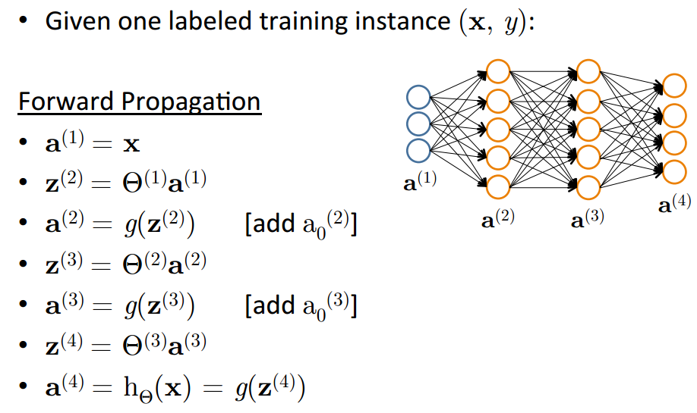
Forward Propagation
Based on slide by Andrew Ng

Slide 19
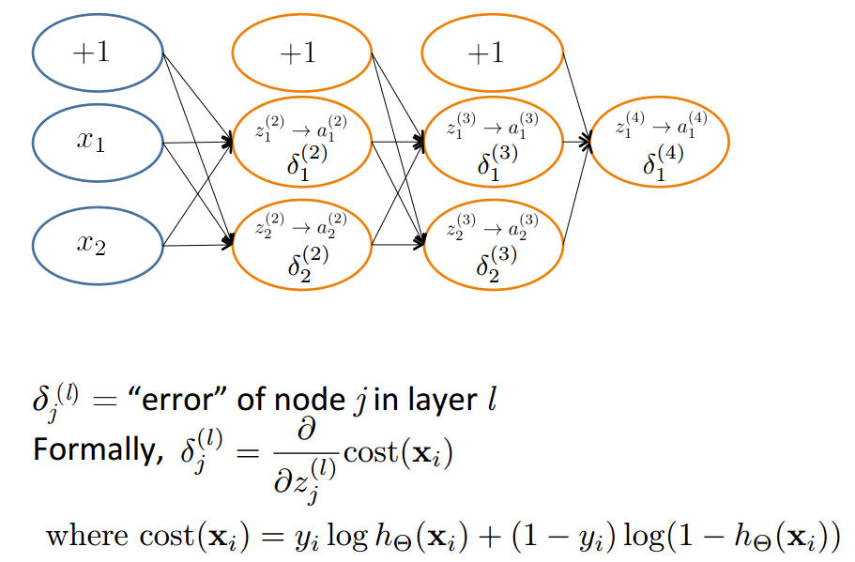
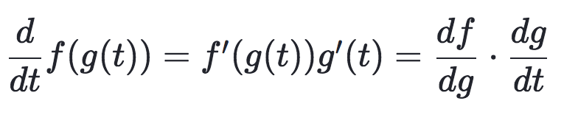
Backpropagation: Compute Gradient
Based on slide by Andrew Ng
36

Slide 20
This lecture
Review: Neural Network
Recurrent NN
Representation learning in NLP

Slide 21
How to deal with input with variant size?
Use same parameters
Today is a … </S>
<S> Today is … day

Slide 22
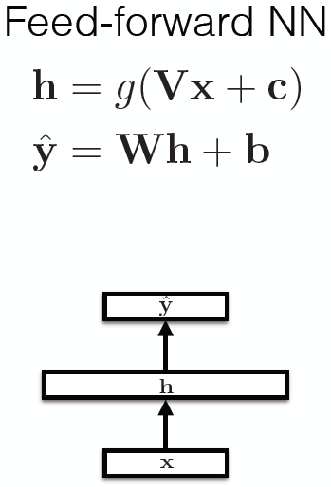
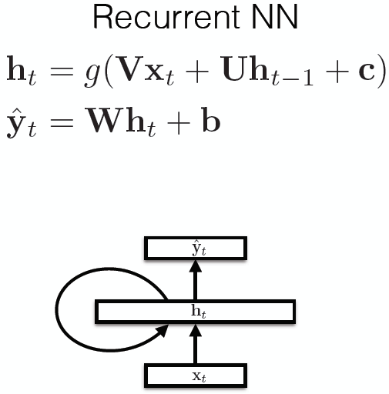
Recurrent Neural Networks

Slide 23
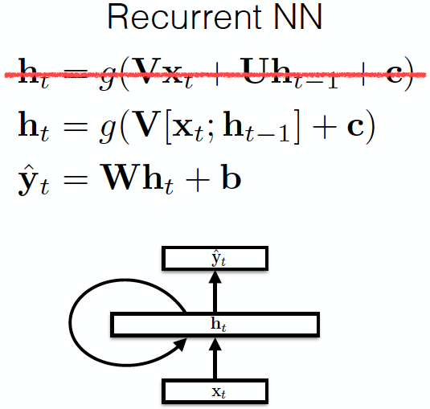
Recurrent Neural Networks

Slide 24
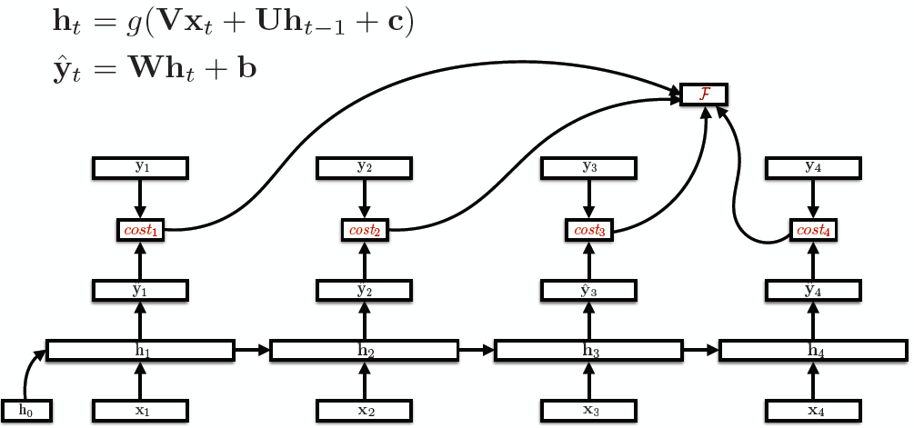
Unroll RNNs
U
V

Slide 25
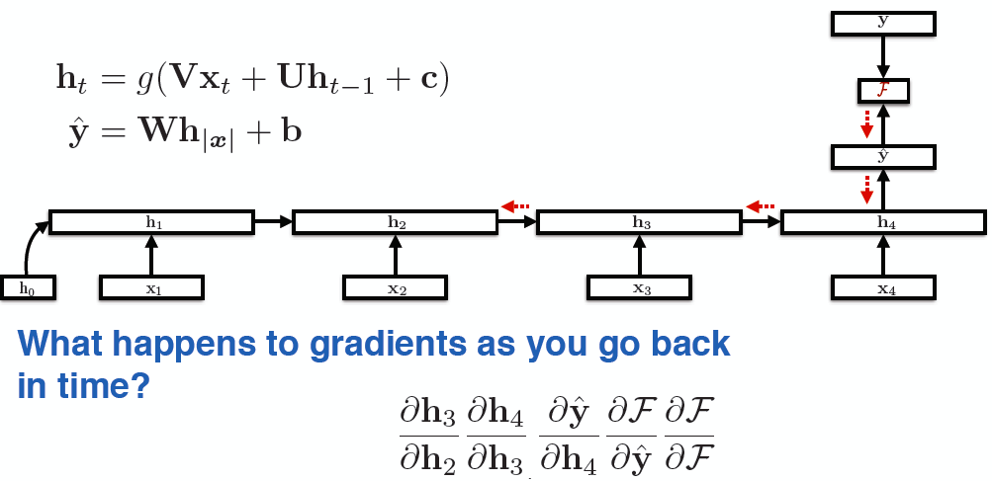
RNN training
Back-propagation over time

Slide 26
Vanishing Gradients
For the traditional activation functions, each gradient term has the value in range (-1, 1).
Multiplying n of these small numbers to compute gradients
The longer the sequence is, the more severe the problems are.

Slide 27
RNNs characteristics
Model hidden states (input) dependencies
Errors “back propagation over time”
Feature learning methods
Vanishing gradient problem: cannot model long-distant dependencies of the hidden states.

Slide 28
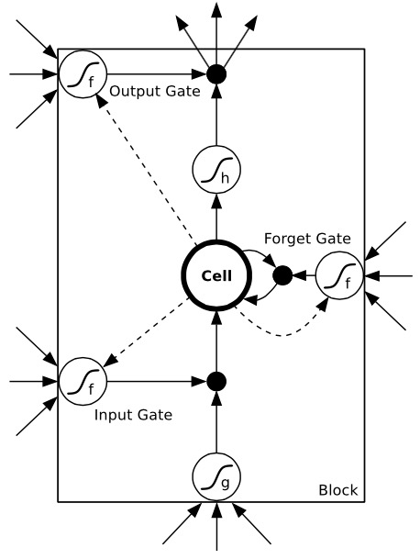
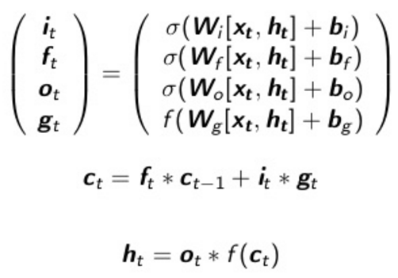
Long-Short Term Memory Networks (LSTMs)
Use gates to control the information to
be added from the input, forgot from the
previous memories, and outputted.
σ and f are sigmoid and tanh function
respectively, to map the value to [-1, 1]

Slide 29
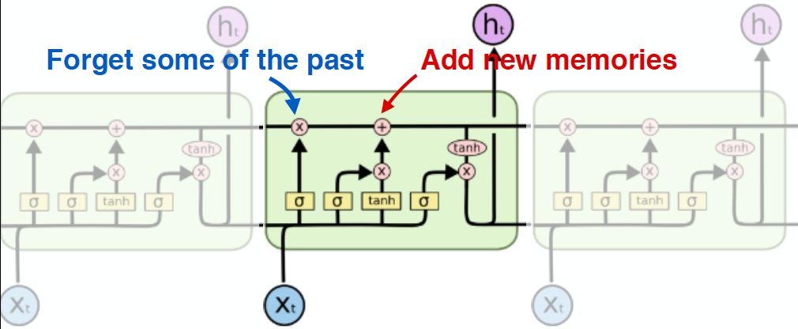
Another Visualization
Capable of modeling long-distant dependencies between states.
Figure credit: Christopher Olah

Slide 30
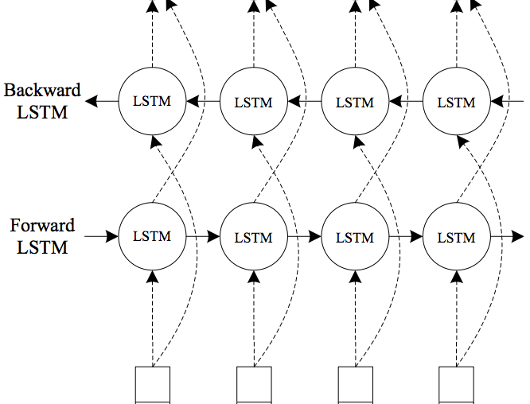
Bidirectional LSTMs

Slide 31
LSTMs for Sequential Tagging
y_{t}
Sophisticated model of input + local predictions.

Slide 32
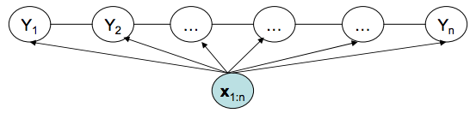
Recall CRFs for Sequential Tagging
Arbitrary features on the input side
Markov assumption on the output side

Slide 33
LSTMs for Sequential Tagging
Completely ignored the interdependencies of the outputs
Will this work? Yes.
Liang et. al. (2008), Structure Compilation: Trading Structure for Features
Is this the best model? Not necessarily.

Slide 34
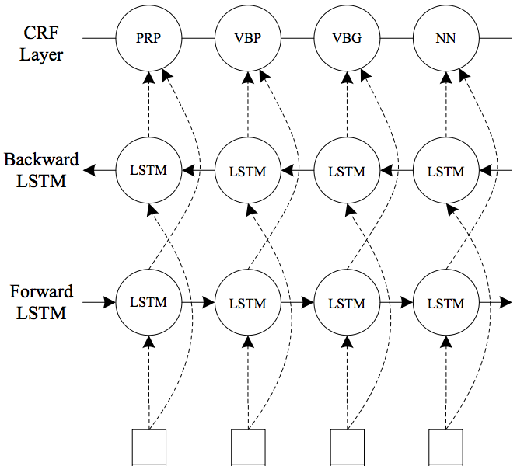
Combining CRFs with LSTMs

Slide 35
Combining Two Benefits
Directly model output dependencies by CRFs.
Powerful automatic feature learning using biLSTMs.
Jointly training all the parameters to “share the modeling responsibilities”

